Slide 1

PMA: Week-2 Understanding Scope and Risk; Work Breakdown Structure (WBS); Risk Categories, Monitoring and Management. Dr. Bhuvan UNHELKAR Professor of Information Technology www.Unhelkar.com; Office: C225; bunhelkar@sar.usf.edu; 941-359-4654

Slide 2
Lecture Agenda
Software Process Architecture (and PMBOK)
What is Scope Management?
Plan Scope Management
Collect Requirements
Defining Scope
Creating Work Breakdown Structure (WBS)
Validate Scope
Control Scope
Risk Categories, Monitoring and Management
Summary & Consolidation

Slide 3

Project Management Institute: PMI® Intellectual Property Acknowledgement
The PMI Registered Education Provider Logo is a registered mark of the Project Management Institute, Inc.
MethodScience is a Registered Education Provider (R.E.P.) of the PMI
Materials in this course are based on the Project Management Institute, A Guide to the Project Management Body of Knowledge (PMBOK® Guide) – Fifth Edition
Project Management Institute, Inc., 2008
PMBOK is a registered trademark of the Project Management Institute, Inc.

Slide 4

Sub-Module Software Process Architecture
As Basis for Project Management Discipline and Frameworks
© MethodScience; Material Designed and Presented by Dr. B. Unhelkar

Slide 5
Figure 4.6: Planned and Agile Elements of Process – basis for Process Configuration – from The Art of Agile Practice by B. Unhelkar, CRC Press, USA, 2013
Roles
Activities
Techniques/Practices
Tasks
Deliverables
Practice
Practice
Practice
Practice
Activity
Activity
Activity
CAMS Process-Map
Elements
Activity
Role
Activity
Role
Role
Role
Tasks
Techniques
Tasks
Techniques
Tasks
Techniques
Tasks
Techniques
Tasks
Tasks
Project-Specific Processes: (Using Process-Maps)
Deliverables
Medium –
Package
Small –
Conversion
Large –
Development

Slide 6
Model of a Process (Helps in Understanding Process Configurations) (based on Unhelkar, 2003)
Process-
component
<<Instantiates>>
SEP
<<based on>>
Lifecycle
{waterfall, spiral,
fountain}
Activity
Deliverable
{templates}
Role
Iteration
{1, 2, 3...}
Increment
{first, second, third…}
Note: This is an informal process metamodel (i.e. not an OMG standard). The process-components provide the building blocks for a SEP. And the SEP is based on a SDLC. Eventually, a configured process is enacted (enactment is not shown here).
Task
Techniques
/Practices

Slide 7
Figure 4.11: Embedding Agile Practices within Activities of Planned Process-Maps
1
Process-Map
Deliverables
Deliverable
5
Activity-3
4
Role-1
Agile Practices
Agile Practices
2
Agile Practices
3
4
Activity-1
Activity-2
2
3
Role-2
Agile Practices
Agile Practices
Agile Practices
1
Agile Practices
Agile Practices
6
Activity-4
5
Role-3
Agile Practices
Planned Process - Elements
Agile Process - Practices
Process Elements from Planned Methods: e.g. Detailed Planning, Modeling, Documentation
Agile Practices include: Standup meetings, Pair Programming, Visible Charting.

Slide 8
Short Exercise
Describe a key difference between the Waterfall and Spiral SDLC : ______________________________________________________________________________________
Write the FIVE elements that Make up a Process Architecture : ______________________________________________________________________________________

Slide 9
Sub-Module Projects and Risks
Based on an Understanding of what is a Project? Elements and Trade-offs;
© MethodScience; Material Designed and Presented by Dr. B. Unhelkar

Slide 10
Starting with Project Management Basics
Project: a planned undertaking to produce results at a specified time
Temporary, non-routine, unique, has a start and end point, requires leadership and management, needs to be measured and reported
Management
the art of getting things done by people
the process of planning, organizing, leading and controlling the efforts of other members of the organization and the use of other organizational resources to achieve stated goals

Slide 11
Project Management
Most corporate work today gets done in a project-based environment
Project teams:
made up of people with complimentary skill sets (i.e.: analyst complimenting developers; and construction engineers complimenting stress testers)
Project manager:
Absolute crucial part of a Project
Must create and manage: Scope, Schedule, People, Costs & Budgets;
Ensure successful and timely completion of the project

Slide 12

Project Management comprises..
Covers a wide variety of issues including project planning, contract management, customer relationship management, human resource management, schedule management, control and reporting
Standards such as Project Management Body of Knowledge (PMBOK® - 5th Edition), Prince2 and SFIA provide industrially accepted FRAMEWORKS for project management
Reflects the Lifecycle of a project in practice

Slide 13
IT Project Management Includes..
Development Management
Deployment Management
Release Management
Training Management
Incident Management
Test Management
Risk Management
Change Management
Configuration Management
Quality Management
Database Management
Service Level Management
Support Management
Outsourcing Management
Capacity Management
Financial Management
Security Management
People Management
Standards Management
Documents Management
Process Management
….?
13

Slide 14
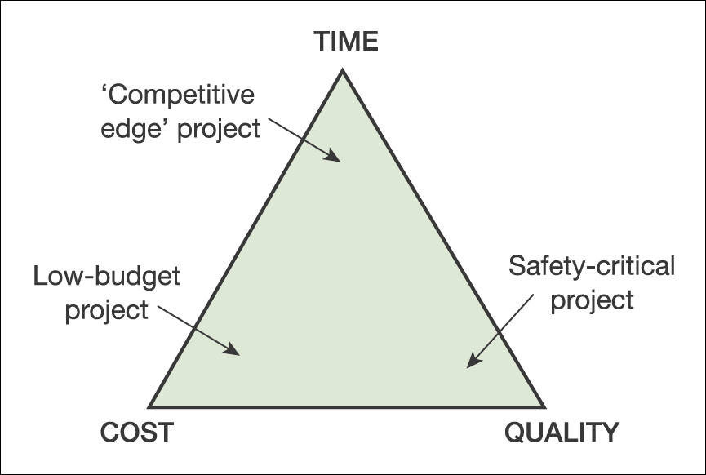
Trade-offs: the ‘triple constraint’
Time/cost/quality triangle for projects

Slide 15
CRITICAL Project Management VARIABLES
Scope
Time
Note: Changing any one of these attributes will almost certainly force a change in one (or more) of the others!
Cost
Quality
15
Curry & Stanford (2005)
©Curry/Stanford(2005)

Slide 16

Short Exercise
You are asked to Project Manage the development of a iPhone5 App. Write an Example corresponding to the following for a typical development:
Time _____________________________________
Scope _____________________________________
Cost _____________________________________
Quality ___________________________________

Slide 17
Areas of Project Management – Each influenced by Agile Values & Principles
Project Management Responsibilities
Organizing; Directing; Staffing; Planning; Controlling, Reporting
Agile: dynamicity; ongoing provisions for change; reuse experience
Project Management Variables
Scope; Time; People; Money; Tools and Techniques; Quality
Agile: Intangibles- Trust, Motivation, Transparency, Courage
Project Management Tasks
Scheduling; Estimating; Monitoring; Contingency Planning; Risk Management
Agile: Collaborating, Communicating, Changing
Project Management Strategy
Deliver results incrementally, build management trust, retain customer involvement -- within time boxes
Agile: Composite of Planned and Dynamic/Flexible practices

Slide 18

Programmes of Work
Programme is Made up of Multiple Projects
Provide significant Strategic value to the organization
Is a Value Stream rather than Output only
Must be continuously aligned with the organization’s mission and vision
Benefits immensely by Agile values
As Business Agility is far more important than Software Agility

Slide 19
Project Failures – a PM perspective
Analysis Viewpoint
Unclear Business Needs
Poor Requirements Management
Projects Viewpoint
Unrealistic Objectives (Budget, Time, Scope)
Non-Traceability of Requirements in Testing
Inflexibility in Changing Requirements
Poor Communication
Poor Expectations Management (with Stakeholders)
Lack of Sr. Management Support
Poor Change Management
Lack of Client/User Involvement
Project Management Incompetence (Planning, Control, Tracking, Reporting)
Overall (Common) Viewpoint
Lack of Training
Lack of Good / Appropriate people
Political Issues

Slide 20
Summarizing the Reasons for Project Failure
Incomplete or changing requirements
Limited user involvement
Lack of executive support
Lack of technical support
Poor project planning
Unclear objectives
Lack of required resources

Slide 21
Some Specific Issues with Software Projects
Unlike construction projects which have tangible objects, software is intangible, and end users do not easily perceive the end product.
It is often hard for end users to express their requirements in a language that the analyst can capture without ambiguity.
The scope of software projects tend to expand as the system design progresses.
It is hard to estimate cost and time for projects where there is a scope creep.

Slide 22
Possible corrective actions in Managing Projects!!
Add more staff
Add different skills
Use overtime
Reassign tasks
Increase supervision
Decrease supervision
Find improved methods
Streamline procedures
Change resource priorities
Re-plan the project
Change the phasing of deliverables
Decrease inspections
Increase inspections
Encourage the team
Introduce incentives
Subcontract some work
Negotiate changes to the specification

Slide 23
Project Success Factors – Plan, Monitor, Control
Project management is important for success of system development projects
2000 Standish Group Study:
Only 28% of system development projects successful
72% of projects canceled, completed late, completed over budget, and/or limited in functionality
Agile approaches are improving success rates
Projects requires careful planning, control, and execution

Slide 24
Summarizing Reasons for Project Success
Clear system requirement definitions
Substantial user involvement
Support from upper management
Thorough and detailed project plans
Realistic work schedules and milestones
Notes:
User involvement extremely important

Slide 25
PM Generic Approach (A View from the Trench of a PM)
1: Hire the best.
I was very lucky to meet some of the best in the game, I hire them. They have a track record and are like money in your pocket, they WILL deliver.
2: Involve business.
SET the expectation from day one, and banish non project people. The sales guys have done their job, time for you to deliver on their promises and smiles.
3: Be realistic.
Rather tell the client what has been agreed is not doable anymore, but them WHY, and give the alternatives.
4: Be honest.
This is my single biggest success factor "tip" in all the years I have been doing this job. In every single instance, after the dust had settled, the client has come to me to thank me, and I have been retained on the project.

Slide 26
Short Exercise
Give TWO reasons why your iPhone App project can FAIL. Write very briefly how that Failure can be avoided by you (based on your general knowledge):
_______________________________________
_______________________________________
_______________________________________
_______________________________________

Slide 27
Sub-Module Project Management Body of Knowledge (PMBOK)
www.pmi.org
Based on Plan-Driven Life cycles
© MethodScience; Material Designed and Presented by Dr. B. Unhelkar

Slide 28
Why use formal techniques?
Justification of work and changes
Improved tracking of critical variables
Identify tasks at differing levels of complexity
Decrease project costs
Everyone knows how they fit in
Improved client reporting
Opportunities to decrease development time/costs and increase productivity and reusability “If you fail to plan then plan to fail”
Role of Project manager
28

Slide 29
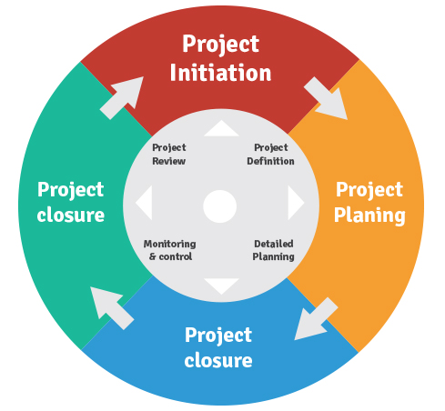
Starting Project Management with a Typical Project Lifecycle
Initiation
Planning
Execution
Monitor (Control)
Close

Slide 30
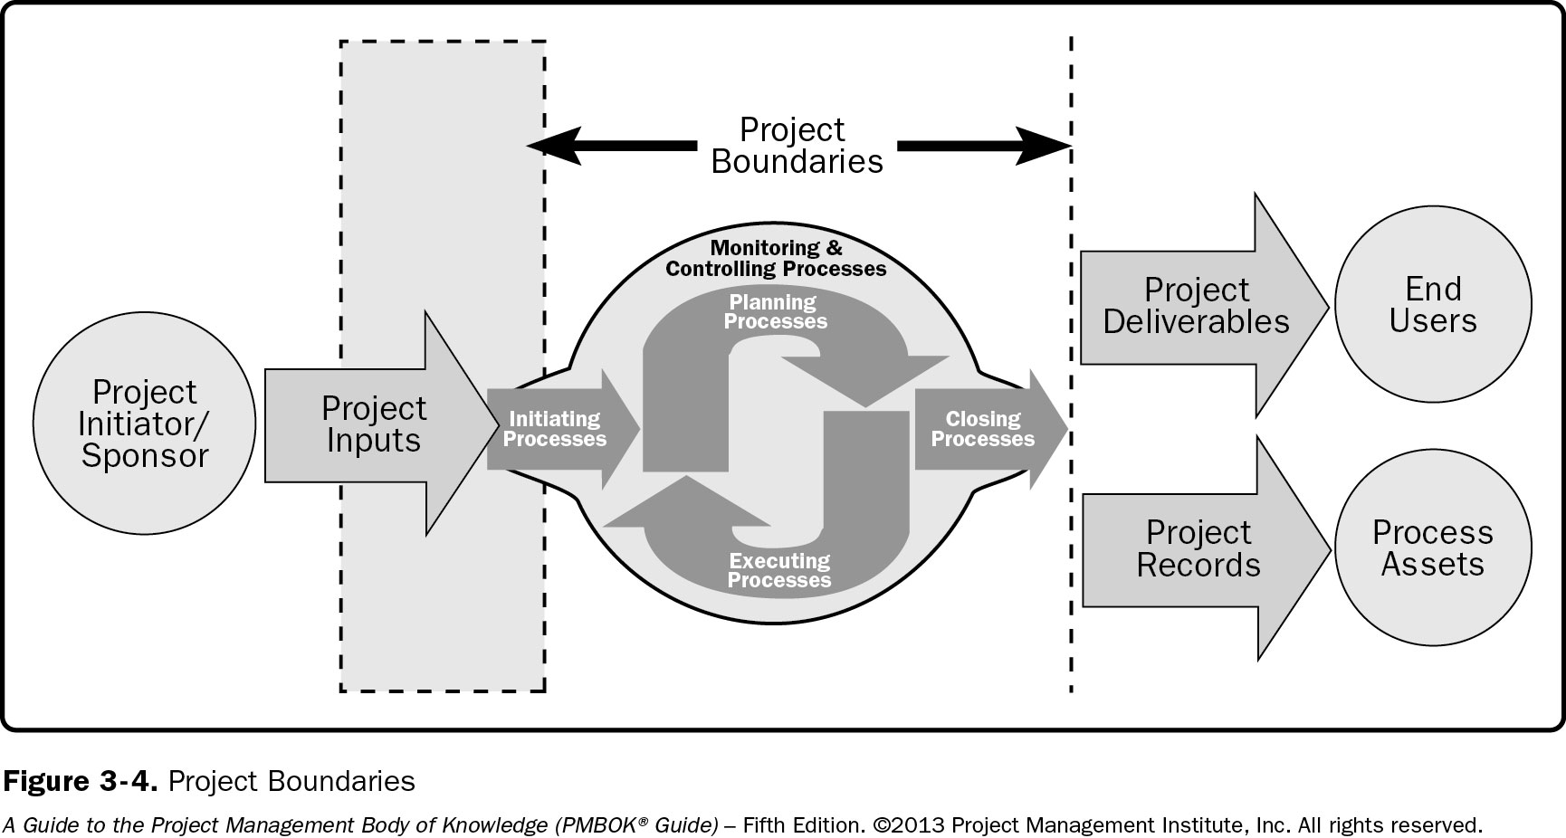
Process-Groups operate within Project Boundaries – taking Inputs and producing Outputs

Slide 31
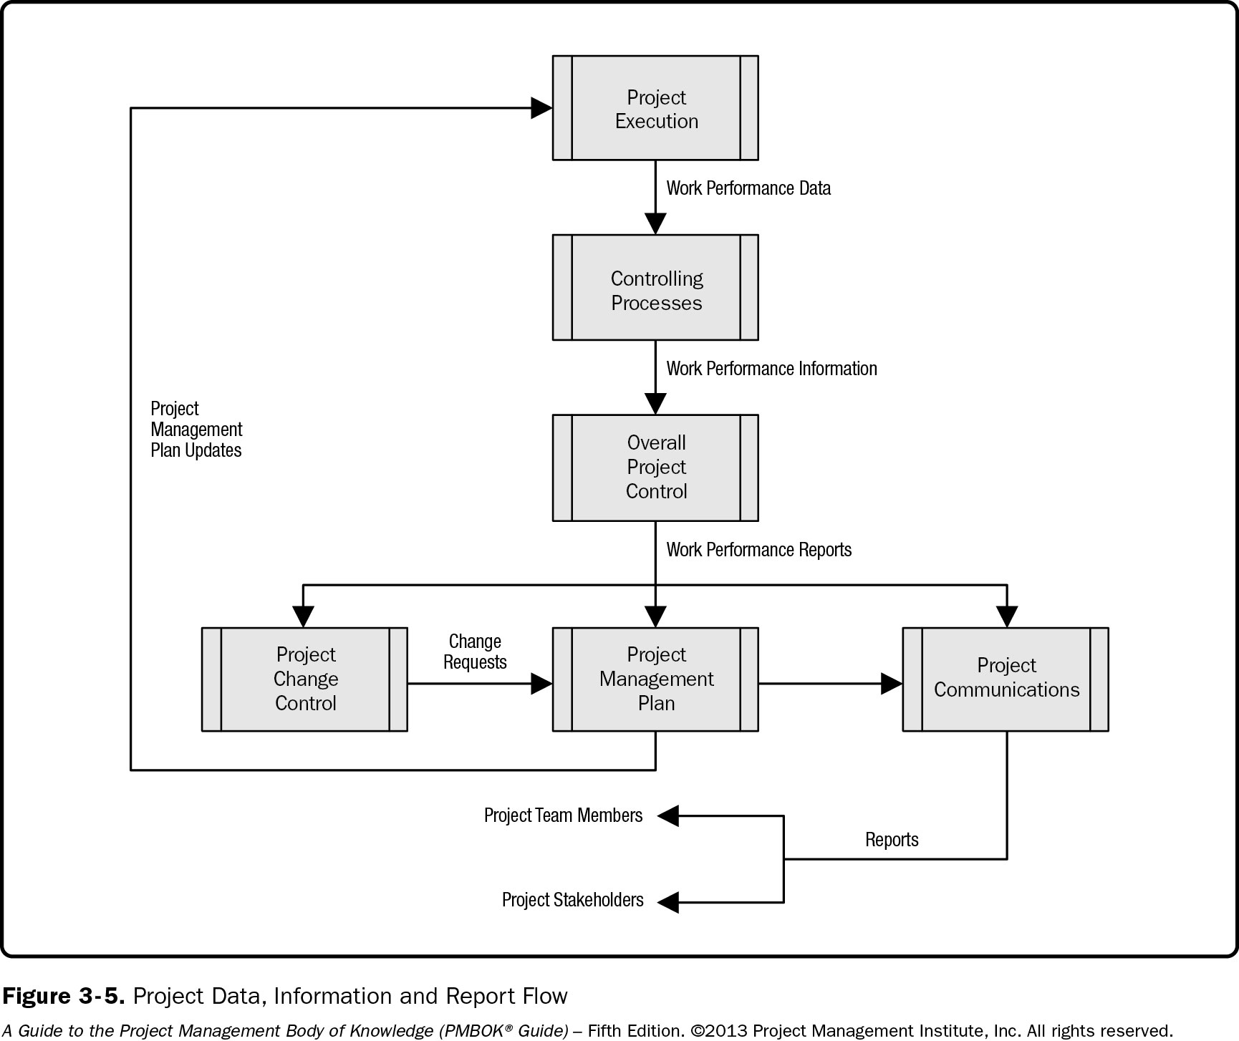
Flow of Project Information

Slide 32
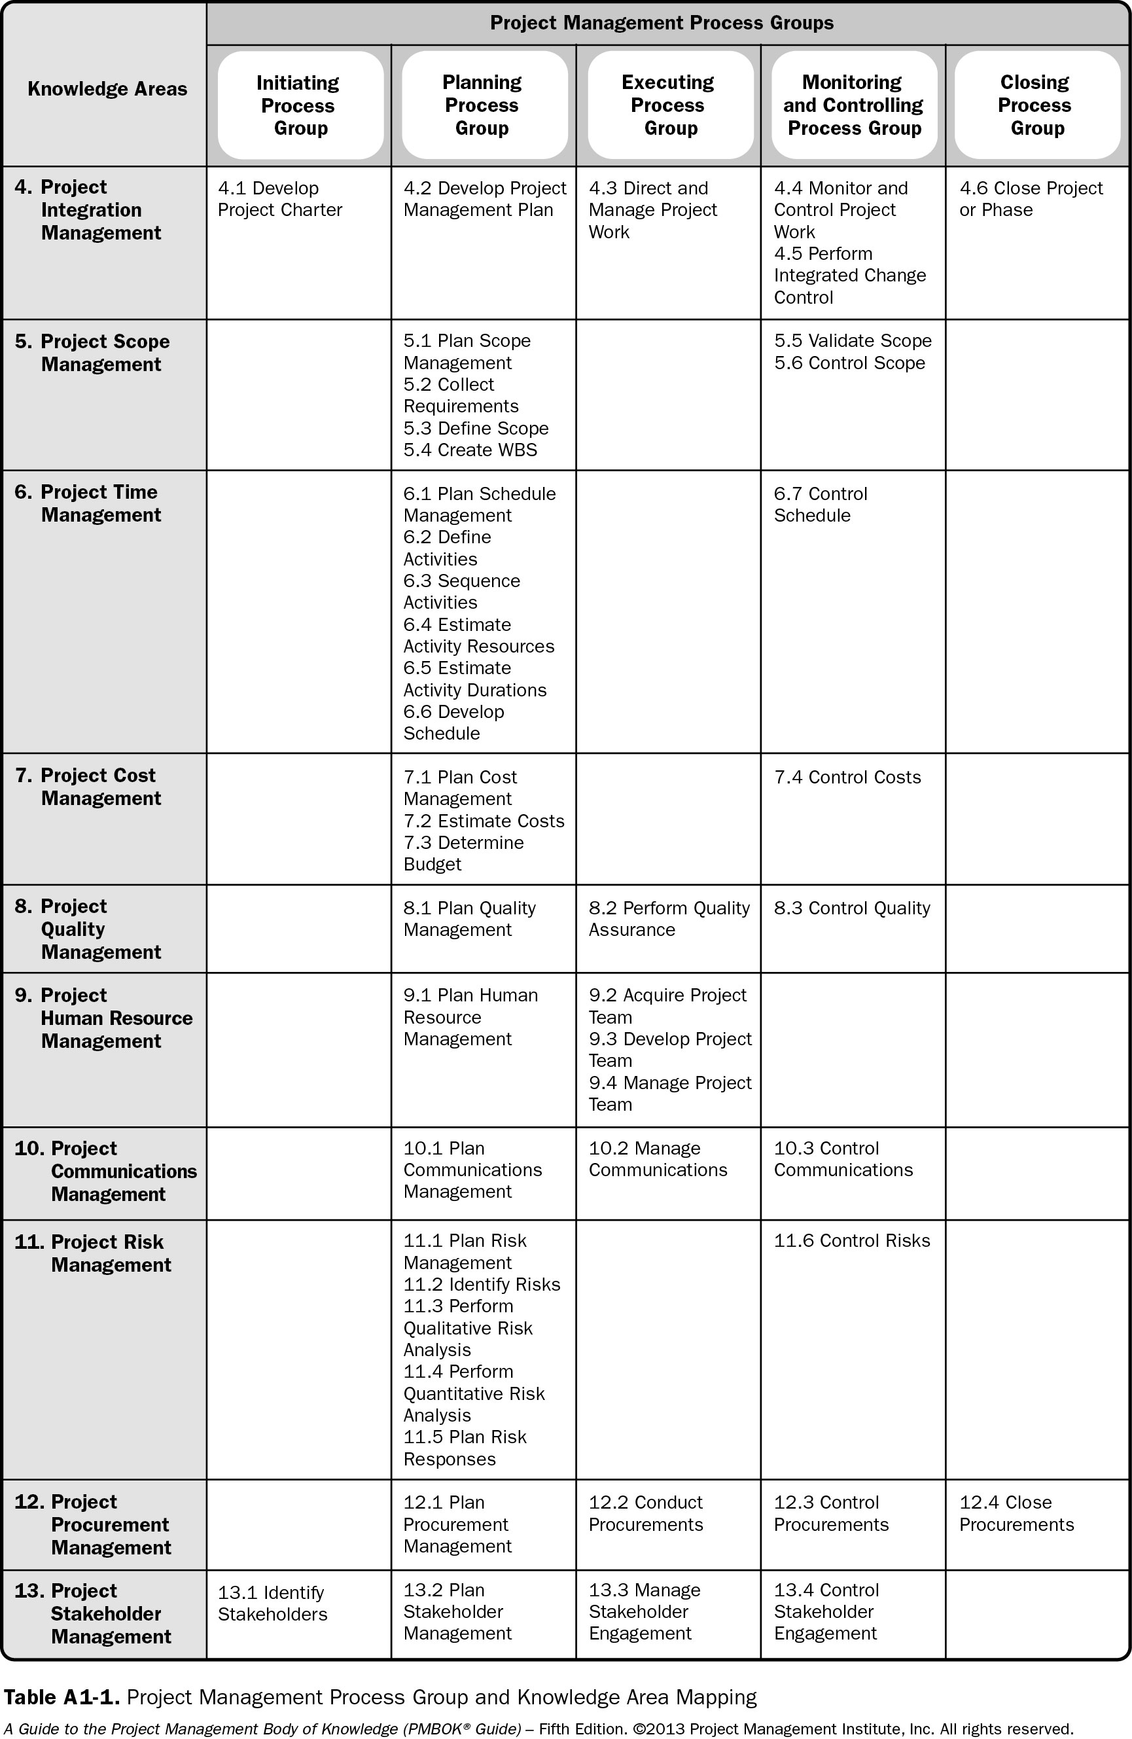
Process Groups – Knowledge Areas

Slide 33


Each Process has
Inputs
Tools & Techniques
Outputs

Slide 34
Short Exercise
List a Knowledge Area from PMBOK that you think you will like – and write a process next to it that you like; Repeat the same for a Knowledge Area that you may not Like:
_______________________________________
_______________________________________
_______________________________________
_______________________________________

Slide 35

Sub-Module PROJECT SCOPE MANAGEMENT
Defining and controlling what is and is not included in the project
© MethodScience; Material Designed and Presented by Dr. B. Unhelkar

Slide 36
Project Management Institute: PMI® Intellectual Property Acknowledgement
The PMI Registered Education Provider Logo is a registered mark of the Project Management Institute, Inc.
MethodScience is a Registered Education Provider (R.E.P.) of the PMI
Materials in this course are based on the Project Management Institute, A Guide to the Project Management Body of Knowledge (PMBOK® Guide) – Fifth Edition
Project Management Institute, Inc., 2008
PMBOK is a registered trademark of the Project Management Institute, Inc.

Slide 37
Process Groups – Knowledge Areas

Slide 38
What is Scope? And Scope Management?
Scope describes what is and is not included within a Project
Scope Management is the effort to ensure that the project includes ALL the work required and ONLY the work required to achieve the Project Objective
Knowing and Declaring what is IN-scope and what is OUT-of-scope is immensely valuable in Expectation Management

Slide 39
Sub-Module 5.1 Plan Scope Management
Planning the Approach – How we will manage the scope?
© MethodScience; Material Designed and Presented by Dr. B. Unhelkar

Slide 40
5.1 Plan Scope Management
Inputs
Tools & Techniques
Outputs
Project management plan
Project charter
Enterprise environmental factors
Organizational process assets
Expert judgment
Meetings
Scope management plan
Requirements management plan

Slide 41
Inputs to Plan Scope Management:
Project Management Plan: Approves subsidiary plans which are to used to create scope management plan.
Project Charter: Provides the project context needed to plan the scope management processes.
Enterprise Environmental Factors: Include infrastructure, marketplace conditions.
Organizational Process Assets: Include policies & procedures, and historical information.

Slide 42
Tools & Techniques of Plan Scope Management:
Expert Judgment: Expertise provided by any group or person with specialized education, knowledge, skill and experience.
Meetings: Helpful in developing the scope management plan. Attendees may include the project manager, the project sponsor, project team members, selected stakeholders.

Slide 43
Outputs of Plan Scope Management:
Scope Management Plan: Describes how the scope will be defined, developed, monitored, controlled, developed, monitored, and verified. Includes the following processes; preparing detailed project scope statement, creation of the WBS from it, approving WBS, and the like.
Requirements Management Plan: Describes how the requirements will be analyzed, documented, and managed. Components include; Configuration management activities, requirements prioritization process, and the like.

Slide 44
3.3_Requirements Management Plan

Slide 45
Short Exercise – Circle the Best Option (Answers Separately Provided)
Q 1: Which of the following is not an input to Plan Scope Management?
[A] Project Management Plan
[B] Change Management Plan
[C] Project Charter
[D] Organizational Process Assets
Q 2: An Important output of Plan Scope Management is:
[A] Organizational Process Assets
[B] Enterprise Environmental Factors
[C] Requirements Management Plan
[D] None of the Above
Notes:
1 – [c] Change Management Plan
2 – [c] Req mgmt plan

Slide 46
Sub-Module 5.2 Collect Requirements
Part of 5: Project Scope Management
© MethodScience; Material Designed and Presented by Dr. B. Unhelkar

Slide 47
5.2: Collect Requirements
Inputs
Tools & Techniques
Outputs
Scope management plan
Requirements management plan
Stakeholder management plan
Project charter
Stakeholder register
Interviews
Focus groups
Facilitated workshops
Group creativity techniques
Group decision-making techniques
Questionnaires and surveys
Observations
Prototypes
Benchmarking
Context diagrams
Document analysis
Requirements documentation
Requirements traceability matrix

Slide 48
Inputs to Collect Requirements:
Scope Management Plan: Guides project teams in determining which type of requirements need to be collected.
Requirements Management Plan: Provides the processes used to define and document the stakeholder needs.
Stakeholder Management Plan: Describes stakeholder communication requirements and the level of stakeholder engagement.
Project Charter: Provides high-level description of the product, service, or result of the project.
Stakeholder Register: Used to identify stakeholders who can provide information on the requirements.

Slide 49
Tools & Techniques of Collect Requirements:
Interviews: Help to elicit information from stakeholders and collect data regarding desired product deliverables from project participants.
Focus Groups: A trained moderator interacts with the group of stakeholders and subject matter experts regarding their attitudes about a proposed product, service or result.
Facilitated Workshops: Interactive sessions that involve key stakeholders and help them define product requirements. May lead to increased consensus. E.g. Quality Function Deployment in the manufacturing industry.

Slide 50
Tools & Techniques of Collect Requirements- 1:
Group Creativity Techniques: Group activities like brainstorming, mind mapping, etc. can be used to identify project and product requirements.
Group Decision-making Techniques: Methods like unanimity, dictatorship, can be used for making decisions regarding classification of product requirements.
Questionnaires and Surveys: Written sets of questions designed to quickly gather information from large number of respondents.
Observations: Also known as “job shadowing”. Usually done by an external observer.

Slide 51
Tools & Techniques of Collect Requirements -2:
Prototypes: Working model of the expected product is termed as prototype. Support the concept of progressive elaboration in cycles of mock-up creation, user experimentation, feedback generation, and prototype revision. E.g. Storyboarding.
Benchmarking: Provides scope for improvement by comparing actual or planned practices to those of comparable organizations.
Context Diagrams: Visually depict the product scope by showing a business system and how people and other systems interact with it.
Document Analysis: Used to elicit requirements by analyzing existing documentation and identifying information relevant to the requirements.

Slide 52
Outputs of Collect Requirements:
Requirements Documentation: Describes how individual requirements meet the business need for the project. It’s components include business requirements, project requirements, transition requirements, and the like.
Requirements Traceability Matrix : Ensures that the approved requirements get converted into deliverables at the end of the project. Tracing includes tracing requirements for business needs, WBS deliverables, product design and the like. Typical attributes used in the matrix may include a unique identifier, owner, source, etc.

Slide 53
3.2_Requirements Documentation

Slide 54
Short Exercise
What will you need to run a Facilitated Workshop to collect Functional Requirements with Use cases and Activity Graphs (remember your UML lessons? – answer in terms of people, tools, UML standards, environment etc.) : _____________________________________________________________________________________________________________________________________________________________________________________________
What is the importance of Requirements Traceability Matrix? (You are welcome to bring your Requirements Engineering knowledge – if you are doing that; else answer based on current discussion) : _______________________________________________________________
_______________________________________________________________
_______________________________________________________________

Slide 55
Sub-Module 5.3 Define Scope
Part of 5: Project Scope Management
© MethodScience; Material Designed and Presented by Dr. B. Unhelkar

Slide 56
5.3: Define Scope
Inputs
Tools & Techniques
Outputs
Scope management plan
Project charter
Requirements documentation
Organizational process assets
Expert judgment
Product analysis
Alternatives generation
Facilitated workshops
Project scope statement
Project documents updates

Slide 57
Inputs to Define Scope:
Scope Management Plan: A component of the project management plan that establishes the activities for developing, monitoring, and controlling the project scope.
Project Charter: Provides the high-level project description and product characteristics. Also contain project approval requirements.
Requirements Documentation: Used to select the requirements to be included in the project.
Organizational Process Assets: Examples of assets that can influence the process include policies for a project statement, project files from previous projects.

Slide 58
Tools & Techniques of Define Scope:
Expert Judgement: Needed to develop the project scope statement. Available from sources like consultants, professional and technical associations, etc.
Product Analysis: Consists of methods for translating high-level product descriptions into tangible deliverables. Includes techniques such as systems engineering, value analysis,
Alternatives Generation: Identifying and developing potential approaches to execute and perform the work of the project.
Facilitated Workshops: Key players participate in these sessions to reach a common understanding of the project objectives and its limits.

Slide 59
Outputs of Define Scope:
Project Scope Statement:
Describes the project scope, major deliverables, assumptions and constraints in detail.
Enables detailed planning, guides work execution, and provides the baseline for evaluating change requests.
The level of detail i.e. work inclusions and exclusions can help determine how well the project scope can be controlled.
Includes product scope description, acceptance criteria, deliverable, project exclusion, constraints and assumptions.
Project Documents Updates: Documents that may be updated include stakeholder register, requirements documentation and requirements traceability matrix.

Slide 60
3.5_Project Scope Statement

Slide 61
Short Exercise
List FOUR major DELIVERABLES that are likely to come out of your Project (based on your understanding of the Case study). Add specific Inclusions and Exclusions to each of your Deliverables.
_____________________________________________________________________________________________________________________________________________________________________________________________
_______________________________________________________________
_______________________________________________________________

Slide 62
Short Exercise – Circle the Best Option (Answers Separately Provided)
Q 1: In order to define Scope you do not need one of the following:
[A] Scope Management Plan
[B] Requirements Documentation
[C] Enterprise Environmental Factors
[D] Project Charter
Q 2: The project Scope Statement Describes:
[A] Project Scope, Minor Deliverables, Assumptions and Constraints
[B] Project Scope, Major Deliverables, Project Metrics
[C] Project Scope, Major Deliverables, Quality Plan
[D] Project Scope, Major Deliverables, Assumptions and Constraints
Notes:
1 – C
2 - D

Slide 63
Sub-Module 5.4 Create Work Breakdown Structure
Part of 5: Project Scope Management
© MethodScience; Material Designed and Presented by Dr. B. Unhelkar

Slide 64
5.4: Create WBS
Inputs
Tools & Techniques
Outputs
Scope management plan
Project scope statement
Requirements documentation
Enterprise environmental factors
Organizational process assets
Decomposition
Expert judgment
Scope baseline
Project documents updates

Slide 65
Inputs to Create WBS:
Scope Management Plan: Specifies how to create, maintain and approve the WBS.
Project Scope Statement: Describes the work that will b performed and the work that is excluded. Also describes the specific restrictions and limitations.
Requirements Documentation: Helps to understand the outcome of the project, and what needs to be done to deliver it and it’s final product.
Enterprise Environmental Factors: Industry-specific WBS standards, relevant to the nature of the project may serve as an external reference sources for creation of the WBS.
Organizational Process Assets: Assets that can influence include policies procedures , and templates for the WBS, project files from previous projects, lessons learned from previous projects

Slide 66
Tools &Techniques of Create WBS:
Decomposition: A technique used for dividing the project scope and project deliverables into manageable work packages. It involves identifying and analyzing the deliverables, organizing the WBS, developing codes to its components, and the like.
Expert Judgment: Used to analyze the information needed to decompose the project deliverables. Provided by trained and experienced individual or group, and predefined templates that may be industry or discipline specific.

Slide 67
Outputs of Create WBS:
Scope Baseline: Approved version of a scope statement, WBS and its associated dictionary, that is used as a basis for comparison.
Project Documents Updates: Project documents that may be updates include requirements documentation, which may need to be updated to include approved changes.

Slide 68
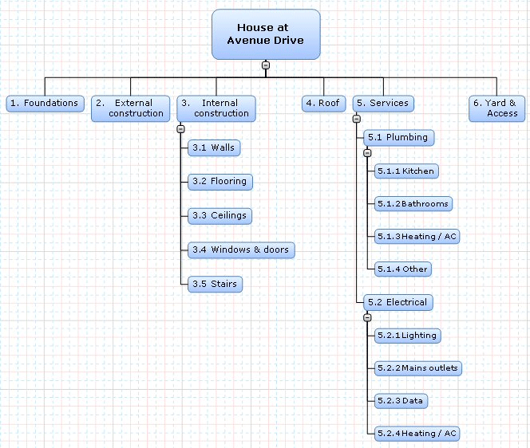
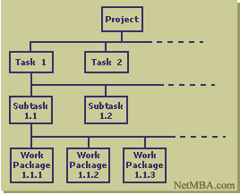
WBS - General
http://www.matchware.com/en/products/mindview/mindview2_be/wbs.htm

Slide 69
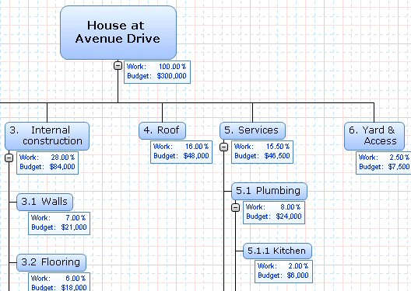
Adding estimates
http://www.matchware.com/en/products/mindview/mindview2_be/wbs.htm

Slide 70
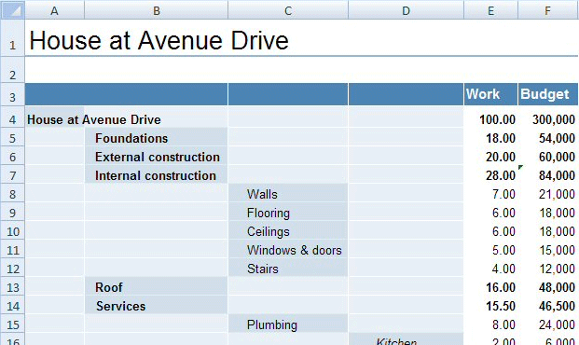
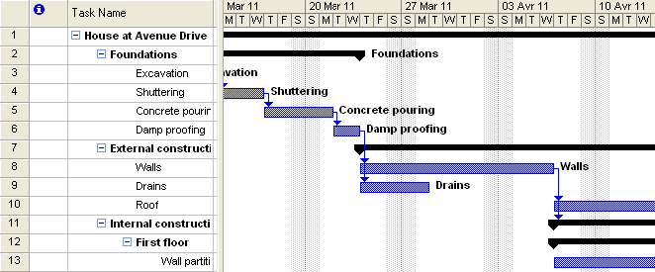
WBS to Gantt Chart
http://www.matchware.com/en/products/mindview/mindview2_be/wbs.htm

Slide 71
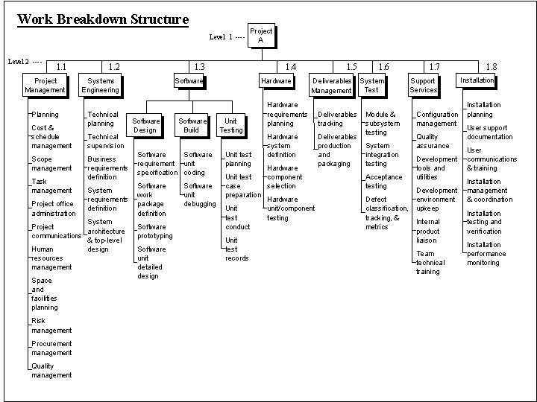
Work Breakdown Structure for an IT Project
http://www.hyperthot.com/pm_wbs_sw1.htm

Slide 72
Short Exercise: Create a Work Breakdown Structure for your Case study Project

Slide 73
3.8_WBS Dictionary

Slide 74
Sub-Module 5.5 Validate Scope
Part of 5: Project Scope Management
© MethodScience; Material Designed and Presented by Dr. B. Unhelkar

Slide 75
5.5: Validate Scope
Inputs
Tools & Techniques
Outputs
Project management plan
Requirements documentation
Requirements traceability matrix
Verified deliverables
Work performance data
Inspection
Group decision-making techniques
Accepted deliverables
Change requests
Work performance information
Project documents updates

Slide 76
Inputs to Validate Scope:
Project Management Plan: Contains the scope management plan and the scope baseline.
Requirements Documentation: Lists all the project, product, and other types of requirements for the project and product, along with their acceptance criteria.
Requirements Traceability Matrix: Links requirements to their origin and tracks them throughout the project life cycle.
Verified Deliverables: Deliverables that are completed and checked for correctness.
Work Performance Data: Include the degree of compliance with requirements, number and severity of nonconformities, and the like.

Slide 77
Tools & Techniques of Validate Scope:
Inspection: Includes activities that determine whether work and deliverables meet requirements and product acceptance criteria. Inspections are also termed as product reviews, audits, and walkthroughs.
Group Decision-Making Techniques: Used to reach a conclusion when the validation is performed by the project team and other stakeholders.

Slide 78
Outputs of Validate Scope:
Accepted Deliverables: Deliverables that meet the acceptance criteria are approved by the customer or sponsor. The acknowledgement is formally documented.
Change Requests: The unaccepted deliverables are documented along with reasons for the same. Those may require a change request to be processed for review and disposition.
Work Performance Information: Includes information about project progress.
Project Documents Updates: Project documents that may be updated include any documents that define the product or report status on product completion.

Slide 79
Short Exercise
What would your actions be if the Scope of your Project is NOT Validated in the final meeting of all Stakeholders? ______________________________________________________________________________________
Why do you think the Unaccepted deliverables should be carefully documented? : ______________________________________________________________________________________

Slide 80
Sub-Module 5.6 Control Scope
Part of 5: Project Scope Management
© MethodScience; Material Designed and Presented by Dr. B. Unhelkar

Slide 81
5.6: Control Scope
Inputs
Tools & Techniques
Outputs
Project management plan
Requirements documentation
Requirements traceability matrix
Work performance data
Organizational process assets
Variance analysis
Work performance information
Change requests
Project management plan updates
Project documents updates
Organizational process assets updates

Slide 82
Inputs to Control Scope:
Project Management Plan: Information used from it include scope baseline, scope management plan, change management plan and the like.
Requirements Documentation: Requirements should be unambiguous, and acceptable to stakeholders. Documenting them facilitates easier detection of any deviation from the scope.
Requirements Traceability Matrix: Helps to detect the impact of any change from the scope baseline on the project objectives.
Work Performance Data: Include the number of change requests received, the number of deliverables completed, etc.
Organizational Process Assets: The assets that can influence the Control Scope process include existing control-related policies & procedures, monitoring and reporting methods to be used.

Slide 83
Tools & Techniques of Control Scope:
Variance Analysis: A technique that uses components like project performance measurements for determining the cause and degree of difference between the baseline and actual performance, and deciding whether corrective or preventive action is required.

Slide 84
Outputs of Control Scope:
Work Performance Information: Includes correlated and contextualized information on how the project scope is performing compared to the scope baseline.
Change Requests: Change request to the components of the project management plan are processed for disposition through Perform Integrated Change Control process.
Project Management Plan Updates: May include Scope baseline and other baseline updates.
Project Documents Updates: include updates to requirements documentation, and requirements traceability matrix.
Organizational Process Assets Updates: Include updates to causes of variances, corrective action chosen , and other types of lessons learned from the project scope control.

Slide 85
Short Exercise – Circle the Best Option (Answers Separately Provided)
Q 1: In order to Control the Scope of your project you need the following:
[A] Project Management Plan and Quality Plan
[B] Quality Assurance Plan and Requirements Traceability Matrix
[C] Requirements Traceability Matrix and Work Performance Data
[D] Work Performance Data and Enterprise Environmental Factors
Q 2: One of the following is not the output of the task Control scope:
[A] Change Requests
[B] Project Management Plan Updates
[C] Organizational Process Assets
[D] Requirements Documentation

Slide 86

Discussion, Q & A, Workshop
What is the contribution of PMBOK (and other such standards) to the PM profession?
How would you Apply PMBOK in a Project? (High level)

Slide 87
Discussion, Q & A, Workshop
Scope can change depending on how your key User interacts with you. Does that mean you should STOP interacting with the key User once the Requirements have been signed off? Why? Why not?
Discuss how Scope relates to Time!
Discuss how Scope relates to Costs!
Discuss how Scope relates to Quality!

Slide 88

Key Points (Summary)
We discussed the basis for project management – the SDLCs
And what comprises a Process Architecture / Elements
Popular SPM frameworks were outlined
We discussed what comprises Project Management
and its Challenges & Risks
PMBOK was outlined in greater detail

Slide 89
Key Points (Summary)
We understood Scope – its creation, variation and control
Scope effectively translates to the overall functionality we are delivering in the solution
Breaking the key objectives down into manageable tasks results in Work Breakdown Structure (WBS) – which forms the basis for Time and Cost additions to the Project Plan.

Slide 90
Conclusions & Future Directions
We discussed…??
Do you see what we see?

Slide 91


References
PMBOK 5th Edition
Project Management for Information Systems – 5th Edition; by James Cadle and Donald Yeates (Pearson, Prentice-Hall), 2008

Slide 92

Project Work (In Group)
1) Ensure you have studied the necessary templates for Scope outputs
2) Discuss amongst your group members how you will distribute the work of completing the templates
3) This is an academic exercise – so, not every role is filled and not every template heading can be completed YET you must make EVERY attempt to complete as much of these templates as you can
4) You may Want to create Links to your completed Templates or embed them in the Project Document

Slide 93
Project Work (In Group)
1) Form Groups as per Tutor’s direction
2) Read the Case study problem
3) Go to the Labs and create a MS project file – this will be ONE file per project (so students have to work together)
4) Create a corresponding EXCEL file for Cost Estimations
5) Enter some tentative data in both files
6) Discuss amongst yourself and show to Tutor

